Slide 1


xx – CSS 3
Design revolution
Notes:
© SUPINFO International University - http://www.supinfo.com
SUPINFO vous permet de partager ce document
Vous êtes libre de :
Partager — reproduire, distribuer et communiquer ce document Remixer — modifier ce document
A condition de respecter les règles suivantes :
Indication obligatoire de la paternité — Vous devez obligatoirement préciser l’origine « SUPINFO » du document au début de celui-ci de la même manière qu’indiqué par SUPINFO International University – Notamment en laissant obligatoirement la première et la dernière page du document, mais pas d'une manière qui suggérerait que SUPINFO International University vous soutiennent ou approuvent votre utilisation du document, surtout si vous le modifiez. Dans ce dernier cas, il vous faudra obligatoirement supprimer le texte « SUPINFO Official Document » en tête de page et préciser notamment la page indiquant votre identité et les modifications principales apportées.
En dehors de ces dispositions, aucune autre modification de la première et de la dernière page du document n’est autorisée.
NOTE IMPORTANTE : Ce document est mis à disposition selon le contrat CC-BY-NC-SA Creative Commons disponible en ligne http://creativecommons.org/licenses ou par courrier postal à Creative Commons, 171 Second Street, Suite 300, San Francisco, California 94105, USA modifié en ce sens que la première et la dernière page du document ne peuvent être supprimées en cas de reproduction, distribution, communication ou modification. Vous pouvez donc reproduire, remixer, arranger et adapter ce document à des fins non commerciales tant que vous respectez les règles de paternité et que les nouveaux documents sont protégés selon des termes identiques. Les autorisations au-delà du champ de cette licence peuvent être obtenues à support@supinfo.com.
© SUPINFO International University – EDUCINVEST - Rue Ducale, 29 - 1000 Brussels Belgium . www.supinfo.com

Slide 2

Course objectives
CSS 3
By following this course, you will be able to:
Enumerate CSS3 attributes
Do media queries
Explain namespaces concept
Use level 3 selectors
Manipulate LESS framework

Slide 3


Course plan
CSS 3
Attributes
Media queries
Namespaces
Selectors level 3
LESS framework

Slide 4
Attributes
CSS 3

Slide 5


Presentation
Attributes
CSS3 is part of HTML5 specification
Probably fully usable in 2022
Developped by W3C and WHATWG
At the moment, partially implemented by browsers
Notes:
- Regroupe certaines specs qui sont encore en développement

Slide 6

Presentation
Attributes
Since CSS 3, new attributes are usable
Can be sorted in four categories
Containers
Backgrounds
Texts
Transforms
We’ll discover them now!

Slide 7

Browser Compatibility
Attributes
Be careful: CSS3 support is still in progress!
Depending on your browser, you may have to prefix attributes by the vendor specific code:
Browser | Property scheme
Internet Explorer | -ms-propertyName
Opera | -o-propertyName
Konqueror | -khtml-propertyName
Gecko based | -moz-propertyName
Webkit based | -webkit-propertyName
Notes:
http://www.w3.org/TR/CSS21/syndata.html#vendor-keywords
http://peter.sh/experiments/vendor-prefixed-css-property-overview/

Slide 8


Containers
Attributes
Box-Shadow:
Set a shadow on blocks
border-radius: left top size color;
div { box-shadow: 4px 4px 2px #AAA; }

Slide 9

Containers
Attributes
Box-sizing:
Allow to override default width and height calculation
box-sizing: type-box;
Where type-box can be:
border-box
padding-box
content-box

Slide 10
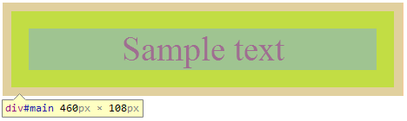
Containers
Attributes
Box-sizing:
Example with content-box:
div {
box-sizing: content-box; padding: 20px;
border:10px solid #AAA; width: 400px;
/* Actual width is 460px (400 + 20*2 + 10*2) */
}

Slide 11
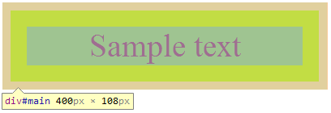
Containers
Attributes
Box-sizing:
Example with border-box:
div {
box-sizing: border-box;
padding: 20px;
border:10px solid #AAA;
width: 400px;
/* Actual width is now
400px */
}

Slide 12

Containers
Attributes
Border-Radius:
Round corners
border-radius: top-left top-right bottom-right bottom-left;
div { border-radius: 10px 5px 20px 0; }
Notes:
Online generator : http://border-radius.com/

Slide 13

Containers
Attributes
Border-Image:
Renders a border based on a specific image
Outputs image over background definitions
border-image: url size x-mode y-mode;
div { border-image: url('css3.png') 20% repeat repeat; }
Notes:
http://www.w3.org/TR/css3-background/#layering

Slide 14
Backgrounds
Attributes
Background-Origin:
Change the default origin for background images
Margins (no box)
Border box
Padding box
Sample text
Content box
Notes:
Given : div { background-image: url('css3.png'); border: 10px solid #AAA; padding: 20px; }

Slide 15


Backgrounds
Attributes
Background-Origin:
Change the default origin for background images
div {
background-origin:
border-box;
}
div {
background-origin:
padding-box;
}
Notes:
Given : div { background-image: url('css3.png'); border: 10px solid #AAA; padding: 20px; }

Slide 16
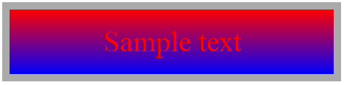
Backgrounds
Attributes
Linear-Gradient:
Advanced gradient tool
background: linear-gradient(color1, color2 [,colorN])
div { background: linear-gradient(red, blue) }
Notes:
More info on http://www.webkit.org/blog/1424/css3-gradients/

Slide 17

Backgrounds
Attributes
Radial-Gradient:
Advanced gradient tool
background: radial-gradient(circle, color1, color2);
div { background: radial-gradient(circle, red, blue) }
Notes:
More info on http://www.webkit.org/blog/1424/css3-gradients/

Slide 18
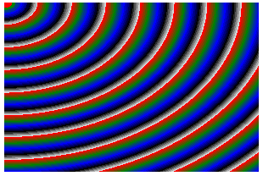
Backgrounds
Attributes
Radial-Gradient can take many parameters in order to perform complex gradients
Complex example:
div {
background:
repeating-radial-gradient(
0 0, ellipse farthest-corner, red 0px,green 10px, blue 20px, black 30px, white 40px
)
}
Notes:
https://developer.mozilla.org/en-US/docs/CSS/Using_CSS_gradients?redirectlocale=en-US&redirectslug=Using_gradients
https://developer.mozilla.org/en-US/docs/CSS/repeating-radial-gradient?redirectlocale=en-US&redirectslug=CSS%2F-moz-repeating-radial-gradient

Slide 19
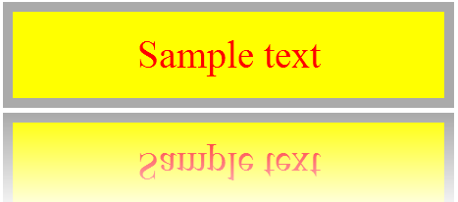
Backgrounds
Attributes
Box-Reflect:
Show a reflection effect on the target
box-reflect: direction margin mask-box;
div { box-reflect: below 5px
linear-gradient(transparent, white); }
Notes:
Other example on : http://stuntsnippets.com/css3-reflection/

Slide 20

Texts
Attributes
Text-Shadow:
Set a shadow on texts
text-shadow: right top size color;
span { text-shadow: 4px 4px 2px #AAA; }

Slide 21

Texts
Attributes
Text-Stroke:
Define a color wrap around texts
text-stroke: size color;
span { text-stroke: 2px black; }

Slide 22
Texts
Attributes
Now you can set columns to blocks!
Use these three properties:
Column-count:
Splits entire text by specified number
Column-gap
Sets margins between each column
Column-width
Specifies each column width

Slide 23
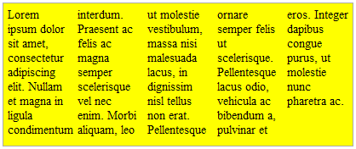
Texts
Attributes
Columns example:
column-count: number;
column-gap: gap;
column-width: width;
Usage:
div {
column-count: 5;
column-gap: 10px;
column-width: 40px;
}
Notes:
On utilise que deux des attributs combinés plutôt que les trois parce que là c’est trop fixé

Slide 24
Transforms
Attributes
Many transformations handled by the transform attribute
Scale
Rotate
Translate
We’ll see all the left ones
Matrix
Perspective
Skew

Slide 25

Transforms
Attributes
ScaleX/Y/Z:
Increase or reduce the element’s dimensions
scaleX(number); scaleY(number); scaleZ(number);
div { transform: scaleX(2); }

Slide 26

Transforms
Attributes
RotateX/Y/Z:
Perform a rotation
rotateX(Ndeg); rotateY(Ndeg); rotateZ(Ndeg);
div { transform: rotateZ(10deg); }

Slide 27

Transforms
Attributes
TranslateX/Y/Z:
Push the element in the specified direction
translateX(Ndeg); translateY(Ndeg); translateZ(Ndeg);
div { transform: translateX(-50px); }
Notes:
In the HTML namespace, the transform property does not affect the flow of the content surrounding the transformed element. However, the extent of the overflow area takes into account transformed elements. This behavior is similar to what happens when elements are offset via relative positioning.
http://www.w3.org/TR/css3-2d-transforms/#transform-rendering

Slide 28


Questions ?

Slide 29

Media Queries
CSS 3

Slide 30
Presentation
Media Queries
Handle CSS declarations depending on media used
Computers
Tablets
Smartphones
…
Two ways to use it

Slide 31
Presentation
Media Queries
In the stylesheet link:
In CSS file directly:
<link rel="stylesheet"
media="screen and (max-width: 600px)"
href="small.css" />
@media screen and (max-width: 600px) {
/* classic CSS here */
}

Slide 32
Media Types
Media Queries
Ten types defined suitable for all displays:
Media type | Usage
all | Suitable for all displays
screen | Classical computer screen
speech | Speech synthesizers
tty | Terminals
tv | Television devices
Notes:
Note : These types exist since CSS 2

Slide 33
Media Types
Media Queries
Ten types defined suitable for all displays:
Media type | Usage
projection | Suitable for projectors
braille | Braille tactile feedback devices.
embossed | Paged braille printers
handheld | Small screen / limited bandwidth
print | Print preview mode (Ctrl + P on browser)
Notes:
Note : These types exist since CSS 2

Slide 34
Min-Width / Max-Width
Media Queries
Max-Width:
Useful for high resolution display:
Min-Width:
Mostly smartphone related:
@media screen and (max-width: 1900px) {
#container { width: 1500px; }
}
@media screen and (min-width: 600px) {
#print-button { display: none; }
}

Slide 35
Max-Device-Width
Media Queries
Min-width and max-width stands for resolution dedicated to browser (eg. window size)
Max-device-width is related to screen resolution
@media screen and (max-device-width: 600px) {
#footer { padding: 0; }
}

Slide 36
Combining media queries
Media Queries
Operator « and » can combine them!
Already seen on previous slides
Operator « , » can associate combinations
@media screen and (max-width: 23em) {}
@media handheld and (min-width: 20em), screen
and (min-width: 20em){}

Slide 37
Combining media queries
Media Queries
Some keywords must be placed in braces:
Used if the screen can render colors:
Operator « not » discard style inclusion if prerequisites are matched:
Not used if the media used is the print preview:
@media screen and (color) {}
@media not print and (color) {}

Slide 38
Additional informations
Media Queries
Useful media queries:
Final note: Internet Explorer 9 and olders simply don’t support media queries.
Media query | Device
all and (max-device-width: 480px) | iPhone
all and (orientation: portrait) | Smartphones and tablet in portrait
all and (orientation: landscape) | Smartphones and tablet in landscape
Notes:
A shorthand syntax is offered for media queries that apply to all media types; the keyword ‘all’ can be left out (along with the trailing ‘and’). I.e. if the media type is not explicitly given it is ‘all’.
I.e. these are identical:
@media all and (min-width:500px) { … } @media (min-width:500px) { … }As are these:
@media (orientation: portrait) { … } @media all and (orientation: portrait) { … }
http://www.w3.org/TR/css3-mediaqueries/

Slide 39
Questions ?

Slide 40

Namespaces
CSS 3

Slide 41
Presentation
Namespaces
Remember the XML attribute « xmlns » ?
Allows to define namespaces
CSS 3 can style XML elements depending on their respective namespaces
We’ll see how in this chapter ☺

Slide 42
XML namespaces
Namespaces
An XML namespace is set by its attribute « xmlns »
The namespace will be declared until the closing tag
Usually all namespaces are set in the first tag
<Enterprise xmlns="http://www.ns.com/ns/Enterprise">
<Enterprise xmlns="http://www.ns.com/ns/Enterprise"
xmlns:manager="http://www.ns.com/ns/Manager"
xmlns:employee="http://www.ns.com/ns/Employee">

Slide 43
Include CSS in XML
Namespaces
Remember the doctype used for XML?
Right after it, include your stylesheet like this:
<?xml version="1.0" encoding="UTF-8" ?>
<?xml-stylesheet type="text/css" href="ns-style.css" ?>

Slide 44
XML namespace syntax
Namespaces
How to include a specific tag in a namespace?
<namespace:theTag> </namespace:theTag>
Non-prefixed tag belongs to the main namespace
<manager:Manager>Manager stuff</manager:Manager>
<info>Some unrelated informations</info>

Slide 45
<?xml version="1.0" encoding="UTF-8" ?>
<?xml-stylesheet type="text/css"
href="ns-style.css" ?>
<Enterprise xmlns="http://www.ns.com/ns/Enterprise"
xmlns:manager="http://www.ns.com/ns/Manager"
xmlns:employee="http://www.ns.com/ns/Employee">
<manager:Manager>
<manager:FirstName>Barney</manager:FirstName>
<manager:LastName>Stinson</manager:LastName>
</manager:Manager>
<employee:Employee>
<employee:FirstName>John</employee:FirstName>
<employee:LastName>Doe</employee:LastName>
</employee:Employee>
<info>Description of the enterprise</info>
</Enterprise>
Complete XML example

Slide 46
What about CSS?
Namespaces
In CSS, define your namespaces as follows:
CSS namespaces are linked to XML namespaces thanks to the URL provided in both files:
In this example, root CSS namespace will concern all tags with the « Enterprise » namespace.
@namespace url("http://www.ns.com/ns/Enterprise");
@namespace manager url("http://www.ns.com/ns/Manager");
@namespace employee url("http://www.ns.com/ns/Employee");

Slide 47
What about CSS?
Namespaces
After namespaces declaration, use it!
Selector | Target
ns|a | Represents tag a in the namespace ns
|b | Represents tag b that belongs to no namespace
*|c | Represents tag c in any namespace
d | Represents tag d in the root namespace (as classical CSS)
manager|Manager { color: red; }
Enterprise employee|FirstName { color: green; }
*|LastName { font-weight: bold; }

Slide 48

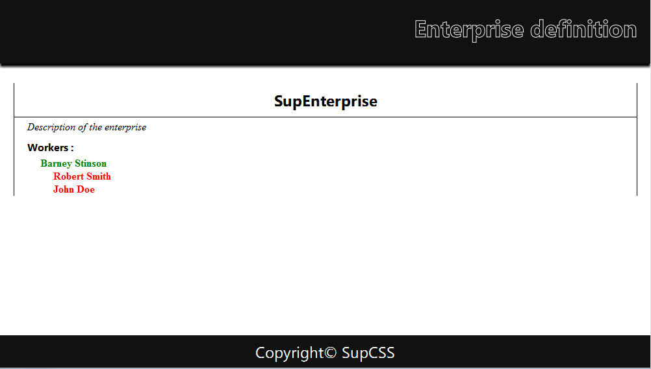
Xml Rendering
Namespaces
Now you can style XML as easily as HTML!

Slide 49
Questions ?

Slide 50
Exercise (1/2)
Namespaces
Get the XML file you want on the web (ex: RSS feed)
If you have no idea, take this one:
http://www.w3schools.com/xml/simple.xml
Enrich it with some logical namespaces
Style it with CSS and render it as a classical HTML page
Use CSS transformations on an element

Slide 51
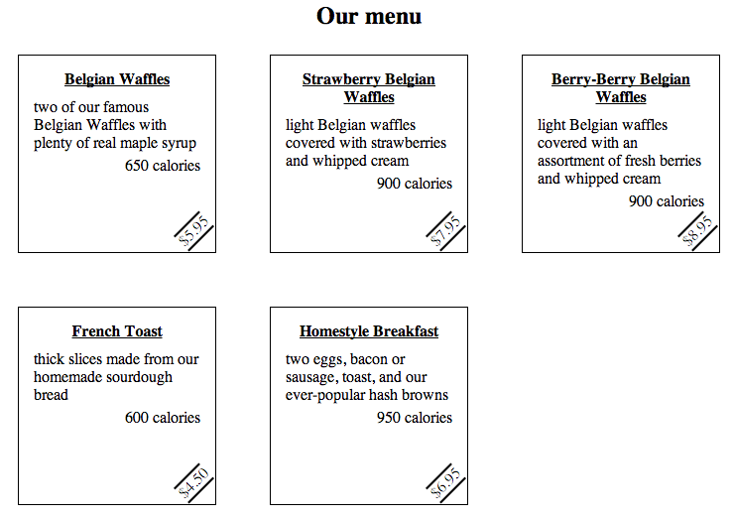
Exercise (2/2)
Namespaces
Possible rendering:

Slide 52

Selectors level 3
CSS 3

Slide 53
Why new selectors?
Selectors level 3
CSS 2 uses some specific selectors which targets specific HTML elements
Also available in CSS 3!
Several manipulations were impossible before
Target odd or even rows in a table
Find all disabled elements
Use regular expressions on attributes
…

Slide 54
What is new?
Selectors level 3
New selectors (1 of 3):
Selector | Targetting
E[foo^="bar"] | An E element whose "foo" attribute value begins with "bar"
E[foo$="bar"] | An E element whose "foo" attribute value ends with "bar"
E[foo*="bar"] | An E element whose "foo" attribute value contains the substring "bar"
E:root | An E element, root of the document
E ~ F | An F element preceded by an E element
Notes:
Besides the root element of an HTML document is « html », it’s not the case in XML based document !
E:root can be useful in some cases (define a layout no matter which XML is sent to the client)

Slide 55
What is new?
Selectors level 3
New selectors (2 of 3):
Selector | Targetting
E:nth-child(n) E:nth-last-child(n) | An E element, the n-th child of its parent… …counting from the last
E:nth-of-type(n) E:nth-last-of-type(n) | An E element,the n-th sibling of its type… …counting from the last
E:first-child E:last-child | An E element, first child of its parent… … counting from the last
E:empty | An E element that has no children (including text nodes)
Notes:
More info on nth* selectors here : http://www.w3.org/wiki/CSS/Selectors/pseudo-classes/:nth-child

Slide 56
What is new?
Selectors level 3
New selectors (3 of 3):
Selector | Targetting
E:odd | An odd E element inside its parent container
E:even | An even E element inside its parent container
E:target | An E element targetted by the referring URI (#anchor)
E:enabled E:disabled | An E element which is enabled… …or disabled
E:checked | An UI element E which is checked (radio button, checkbox)
E:not(s) | An E element that does not match the simple selector s
Notes:
More information on E:target here : http://webdesignernotebook.com/css/the-css3-target-pseudo-class-and-css-animations/

Slide 57
Questions ?

Slide 58
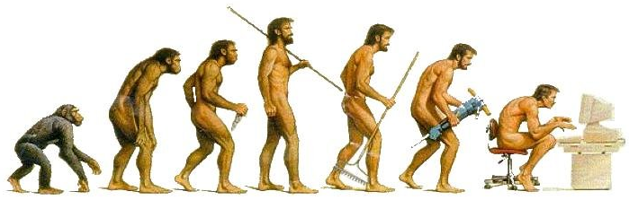
Transitions
CSS 3

Slide 59
Why transitions?
Transitions
CSS animating was a little criticized first
Because style has been static since the beginning!
Think of transitions as dynamic styling
Allows to change CSS properties, but in a smooth way
Each time a style is applied to an element, the defined transition occurs

Slide 60
Syntax
Transitions
CSS transitions are composed of four properties:
property: For which property this transition applies
duration: How many seconds the transition takes
timing-function: Selects a built-in transition model
delay: Time to wait before perform transition
transition-property: color;
transition-duration: 1s;
transition-timing-function: ease;
transition-delay: 0s;

Slide 61
Notes
Transitions
transition-property:
Target multiple properties by separating each by a space
Target all properties by using the keyword « all »
transition-timing-function:
Eight methods available: linear, ease, ease-in, ease-out, ease-inout, step-start, step-end, custom*
Combine them by separating each by a space
Live demo showing six of these eight methods:
http://www.catuhe.com/msdn/transitions/easingfunctions.htm
Notes:
*Understanding custom timing functions:
http://www.w3.org/TR/css3-transitions/#transition-timing-function-property
http://matthewlein.com/ceaser/

Slide 62
How to…
Transitions
…write a shortcut to CSS transitions:
…define multiple transitions for each property:
…launch a transition:
By pseudoclasses (:hover, …), or by JavaScript
transition: color 1s ease 0s;
transition: color 1s ease 0s, opacity 0.5s linear 2s [,...];

Slide 63
JavaScript launching example
Transitions
<body>
<style>
p { color: blue; font-weight: bold;
cursor: pointer; }
.dark { color: black;
transition: color 10s ease 0s; }
</style>
<p onclick="this.className = 'dark'">
Join the dark side!
</p>
</body>

Slide 64
Pros and cons
Transitions
Advantages:
Lightweight and easy
Use hardware acceleration
Performs smooth transitions for UI enhancement
Drawback:
Executed one time per action!
So how to write endless transitions (ie animations)
CSS3 has built-in animations called keyframes ☺

Slide 65
Keyframes
Transitions
Defining a keyframe
@keyframes <animation-name> { … }
Inside it, describe the animation with keywords
from and to
percentages for each animation step

Slide 66
Keyframes
Transitions
Example:
@keyframes my-animation {
0% { color: red; }
50% { color: purple; }
100% { color: blue; }
}
@keyframes other-animation {
from { font-size: 16px; }
to { font-size: 30px; }
}

Slide 67
Assigning keyframes
Transitions
CSS « animation » property
Specify which element use which animation
Most useful derivatives:
name: The name defined in keyframes
duration: How many seconds to do the process
iteration-count: Number of repetitions
You can use the keyword « infinite » if you want
timing-function: Same as transitions

Slide 68
Assigning keyframes
Transitions
Example:
#mySuperElement {
animation-name: my-animation;
animation-duration: 1s;
animation-iteration-count: 3;
}
/* Or simpler... */
.otherElements { animation: other-animation 5s infinite; }

Slide 69
Browser Compatibility
Transitions
As new CSS attributes, both keyframes, « transition » and « animation » properties may be used with the vendor prefix
Example with webkit:
@-webkit-keyframes my-animation { /* ... */ }
#myWebkitElement {
-webkit-transition: all 1s ease-inout 5s;
-webkit-animation: my-animation 1s 3;
}
Notes:
http://www.w3.org/TR/CSS21/syndata.html#vendor-keywords
http://peter.sh/experiments/vendor-prefixed-css-property-overview/

Slide 70
Questions ?

Slide 71
Exercise
Transitions
Time to add some animations in your XML design!
Make your elements change with at least one transition and one keyframe

Slide 72
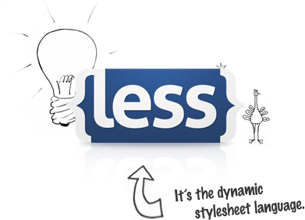
Less CSS
CSS 3

Slide 73
Overview
Less CSS
Dynamic stylesheet language (CSS preprocessor)
Don’t confuse with LESS framework!
LessCSS extends CSS with dynamic behavior
LessFramework allows to design pages easily (bootstrap)
Documentation findable here: http://lesscss.org/

Slide 74
Overview
Less CSS
Open source
Written first in Ruby
Ruby replaced by JavaScript in later versions
Syntax very close to classical CSS
CSS file is a valid Less file

Slide 75
Overview
Less CSS
Can be used in a website in two ways:
By a local compiler who transcripts Less files in CSS files
By uploading Less files and using a JavaScript adapter who converts the code on the fly
Similar projects:
Sass
Zuss

Slide 76

Advantages
Less CSS
Less redundant code
More readable
Thanks to nesting
Advanced concepts:
Variables
Functions
Operations
…

Slide 77
Install
Less CSS
Stylesheet inclusion:
JavaScript adapter inclusion:
<link rel="stylesheet/less" type="text/css"
href="styles.less">
<script src="less.js" type="text/javascript"></script>
Notes:
http://lesscss.org/#-client-side-usage

Slide 78
Nesting
Less CSS
Less CSS
Generated CSS
#header {
h1 {
font-size: 26px;
}
a {
text-decoration: none;
&:hover {
color: black;
}
}
}
#header h1 {
font-size: 26px;
}
#header a {
text-decoration: none;
}
#header a:hover {
color: black;
}

Slide 79
Variables
Less CSS
Less CSS
Generated CSS
@main-color: #FFDEAD;
#header {
h1 {
color: @main-color;
}
}
#container {
border-left: 1px solid
@main-color;
border-right: 1px solid
@main-color;
}
#header h1 {
color: #FFDEAD;
}
#container {
border-left: 1px solid
#FFDEAD;
border-right: 1px solid
#FFDEAD;
}

Slide 80
Operations
Less CSS
Less CSS
Generated CSS
@border-width: 1px;
@dark-gray: #111;
#header {
color: @dark-gray * 3;
}
#container {
border: @border-width * 2
solid @dark-gray;
color: (@dark-gray + #111)
* 4;
}
#header {
color: #333;
}
#container {
border: 2px solid #111; color: #888;
}

Slide 81
Mixins
Less CSS
Less CSS
Generated CSS
.rounded-corners {
border-radius: 5px;
-moz-border-radius: 5px;
-webkit-border-radius: 5px;
}
#header {
.rounded-corners;
}
#container {
.rounded-corners;
}
#header, #container,
.rounded-corners {
border-radius: 5px;
-moz-border-radius: 5px;
-webkit-border-radius: 5px;
}

Slide 82
Mixins with parameters
Less CSS
Less CSS
.rounded-corners(@size) {
border-radius: @size;
-moz-border-radius: @size;
-webkit-border-radius: @size;
}
.border-base(@color: black, @size: 1px) {
border: @size solid @color;
}
#container {
.rounded-corners(5px);
.border-base(#333);
}

Slide 83
Mixins with parameters
Less CSS
Generated CSS
Is it really like functions in other languages?
#container {
border-radius: 5px;
-moz-border-radius: 5px;
-webkit-border-radius: 5px;
border: 1px solid #333;
}

Slide 84
Mixins overloading
Less CSS
Less CSS
Generated CSS
.grady(@a) {
color: @a;
}
.grady(@a, @b) {
color: fade(@a, @b);
}
#container { .grady(#555); }
#footer {
.grady(black, 50%);
}
#container {
color: #555;
}
#footer {
color: rgba(0, 0, 0, 0.5);
}

Slide 85
Built-in functions - Color
Less CSS
Color changing functions (1 of 2):
Decline your entire layout by only two colors!
Example | Champ 2
lighten(@color, 10%); | Return a color 10% lighter than @color
darken(@color, 10%); | Return a color 10% darker than @color
saturate(@color, 10%); | Return a color 10% more saturated than @color
desaturate(@color, 10%); | Return a color 10% less saturated than @color
mix(@color1, @color2); | Return a mix of @color1 and @color2

Slide 86
Built-in functions - Color
Less CSS
Color changing functions (2 of 2):
Decline your entire layout by only two colors!
Example | Champ 2
fadein(@color, 10%); | Return a color 10% less transparent than @color
fadeout(@color, 10%); | Return a color 10% more transparent than @color
fade(@color, 50%); | Return @color with 50% transparency
spin(@color, 10); | Return a color 10 degree larger in hue than @color
spin(@color, -10); | Return return a color 10 degree smaller hue than @color

Slide 87
Conditional statements
Less CSS
Less CSS handles conditions!
Begins with « when »
Optionnaly followed by « and », « , » (logical OR), « not »
.fontcolor(@bg-opacity) when (@bg-opacity =< 0.5) {
color: black;
}
.fontcolor(@bg-opacity) when (@bg-opacity > 0.5) {
color: white;
}
#container { opacity: 0.5; .fontcolor(0.5) ; }

Slide 88

Conditional statements
Less CSS
Five operators:
=>
>
=
<
=<
Only dimension and keywords are comparable

Slide 89
Additional informations
Less CSS
Less can be compiled and minified server side for a perfect integration with nodeJS and Rhino.
You’ll see it in the next semester!
Note: At the time of this writing Chrome doesn’t support Less.js if the path to your page starts with "file:///".
Notes:
You can find a workaround for Chrome by using a HTTP server on your local machine (like WAMP).

Slide 90
Questions ?

Slide 91

The end
CSS 3
Thanks for your attention

